Slide 1
Normalization — How
(1NF, 2NF, 3NF)

Slide 2
Today's Objectives
By the end of this lesson, you will be able to:
Explain the purpose of database normalization
Describe the characteristics of First, Second, and Third Normal Form
Identify repeating groups, partial dependencies, and transitive dependencies
Apply normalization rules to transform unnormalized data into 3NF
Explain how business rules affect database design
Create normalized database schemas from business scenarios
Evaluate normalization and denormalization trade-offs

Slide 3
Where Are We in the Course?
Review from Day 4
Today's Focus:
How do we actually do normalization? What are the specific rules?
Concept | Summary
Normalization | A set of rules for designing relational databases
Redundant Data | Data stored in multiple places unnecessarily
Update Anomaly | Changing data creates inconsistency
Insert Anomaly | Adding data creates inconsistency
Delete Anomaly | Deleting data causes loss of unrelated data

Slide 4
The Problem with Large Tables
Large tables with many columns can be difficult to understand.
They also:
Increase redundant data within the database
Increase the likelihood of anomalies occurring
The Normalization Process provides:
A systematic method of breaking down large tables into a group of related, smaller-sized tables.
These smaller tables:
Benefit | Explanation
Easier to Understand | Each table has a single, clear purpose
Minimize Redundancy | Data is stored in one place
Minimize Anomalies | Updates, inserts, and deletes are safer

Slide 5
Brainstorming Activity
Think about a real-world scenario:
A company stores all employee, department, and project information in one large table.
Discuss:
Why can large tables become difficult to maintain?
What problems occur when the same information appears in multiple places?
Why might changing one record create inconsistencies?

Slide 6
The Normal Forms
The normalization process is based on a set of rules. Each normal form represents a set of rules, This course focuses on 1NF, 2NF, and 3NF:
Normal Form | Description
First Normal Form (1NF) | Remove repeating groups
Second Normal Form (2NF) | Remove partial dependencies
Third Normal Form (3NF) | Remove transitive dependencies
Boyce-Codd Normal Form (BCNF) | A revision of 3NF
Fourth Normal Form (4NF) | Additional rules for multi-valued dependencies
Domain-Key Normal Form (DKNF) | Theoretical ultimate form (not fully defined)

Slide 7
The Trade-Off
As the number of tables increases as in the example.
Normalization is a trade-off between:
Ease of maintenance and performance
Third Normal Form (3NF) strikes the best balance for most applications. Most relational databases are designed to comply with 3NF.
Positive | Negative
Data redundancy decreases | Overhead increases
Likelihood of anomalies decreases | Performance can suffer
Database is easier to maintain | More complex queries (joins)

Slide 8
What is Denormalization?
Denormalization is the process where, after completing a design that meets the rules of normalization, you adjust the design and introduce violations.
Why would you do this?
Important:
Denormalization is a deliberate trade-off. You accept some redundancy to gain performance or usability.
We will see an example of denormalization in the IQ School database later in the course.
Reason | Explanation
Performance | Sometimes joins are slow; storing redundant data can speed up queries
Ease of Use | Sometimes a denormalized design is easier for users to understand

Slide 9
Normal Forms Are Based on Keys
Concept | Description
Primary Key | Uniquely identifies a row in a table. Every table has a primary key.
Business Rules | The database design must reflect the business policies of the organization.
Before looking at the specific rules, we must understand two critical concepts:
Critical Warning:
If a mistake is made in selecting the primary key for a table, the normalization process will NOT produce a good database design.

Slide 10
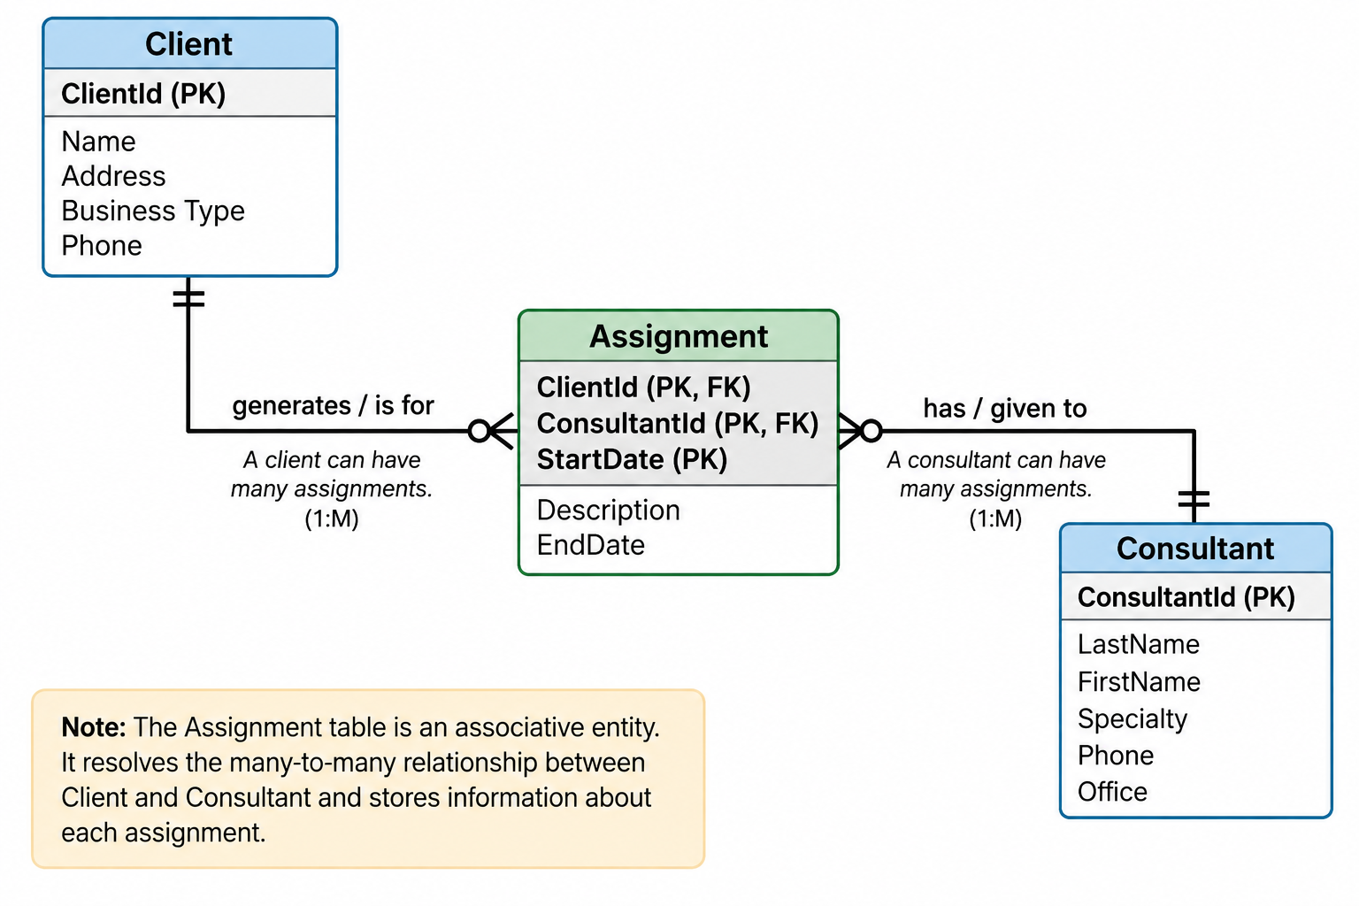
Business Rules Affect Design
Consider a consulting firm that tracks consultants, clients, and assignments.
Business Rule Option 1:
A client can be served by many different consultants based on the type of service requested.
This creates a M:N relationship between Clients and Consultants.
Result: The normalization process creates an Assignment table with a composite primary key of ClientId, ConsultantId, and StartDate.

Slide 11
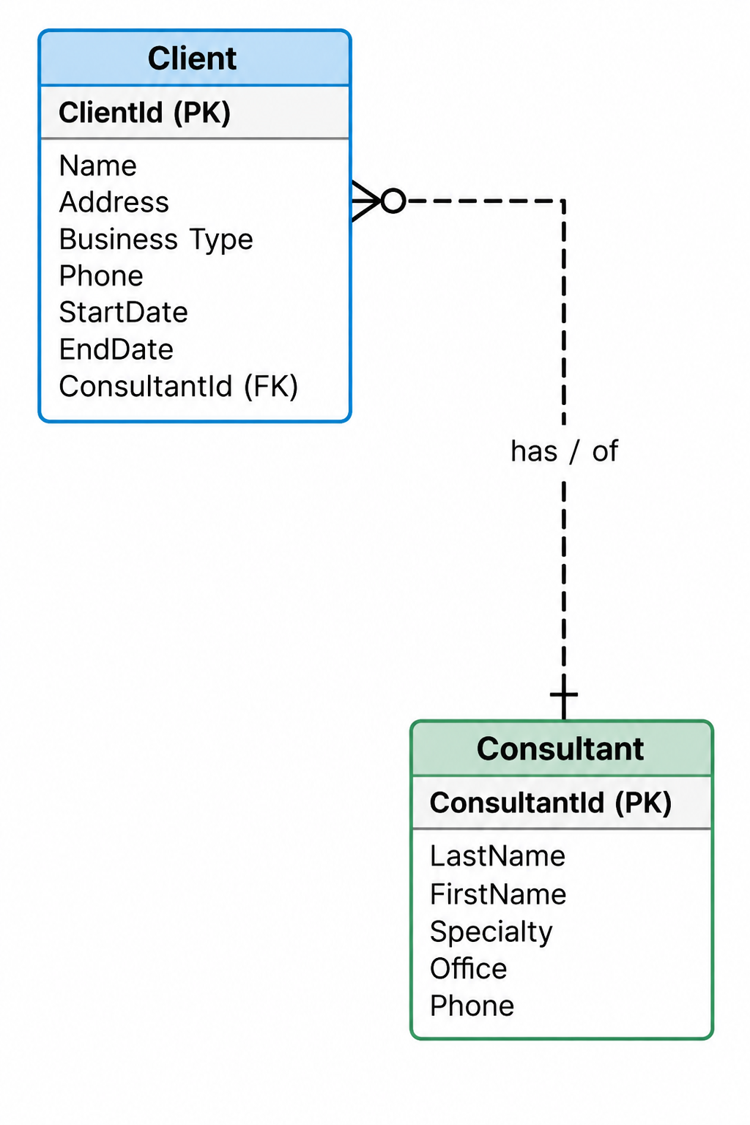
Business Rules Affect Design
Business Rule Option 2:
A client is permanently assigned to one consultant who provides all services.
This creates a 1:M relationship between Consultants and Clients.
Result: The Assignment table is no longer required to track which consultant is assigned to which client.
Key Takeaway:
Different business rules produce different database designs. The designer must understand the business rules before normalizing.

Slide 12
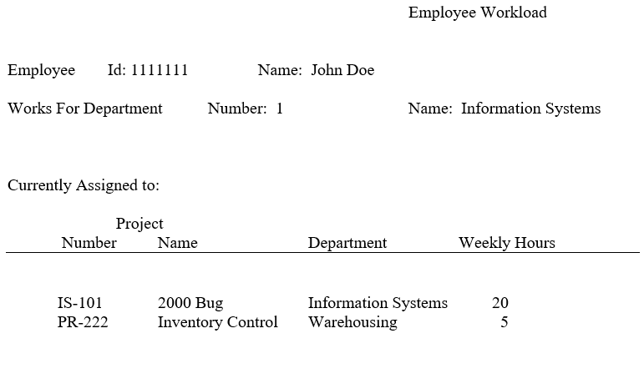
The Employee Workload View
Scenario: A manager needs to determine the department an employee is assigned to and the projects the employee is currently working on.
Business Rules:
An employee works for a single department.
A department can have many employees.
A single department develops a project.
A department can develop many projects.
An employee can be assigned to a maximum of 4 projects.
A project can have many employees.
Employee ID, Department Number, and Project Number uniquely identify employees, departments, and projects.

Slide 13
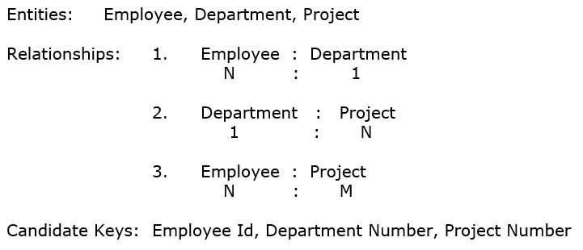
Step 0 — Identify Entities and Relationships
Before applying normalization rules, understand the data
Why is this important?
You need to understand the data before you can organize it properly.

Slide 14
Step 1 — Create the Initial Table
The initial table contains ALL data items in the view.
Rules:
Must have a primary key that uniquely identifies each row
Repeating groups are listed in parentheses
Notation:
Symbol | Meaning
Underline | Primary Key
( ) | Repeating Group

Slide 15
Step 1 — Selecting the Primary Key
We have three candidate keys. Which one should be the primary key?
Decision:
Employee ID must act as the primary key for the initial table.
Candidate Key | Can It Uniquely Identify a Row? | Why?
Employee ID | Yes | Each row records information about one employee
Department Number | No | A department can have many employees
Project Number | No | A project can have many employees

Slide 16
Step 1 — Identifying the Repeating Group
Attribute | Multiple Values? | Forms Repeating Group?
Employee ID | No | No
Name | No | No
Department Number | No | No
Department Name | No | No
Project Number | Yes | Yes
Project Name | Yes | Yes
Sponsoring Department Name | Yes | Yes
Weekly Hours | Yes | Yes
A repeating group is one or more attributes that have multiple values within the view.
Repeating Group: (Project Number, Project Name, Sponsoring Department Name, Weekly Hours)

Slide 17
Step 2 — Apply 1NF Rules
1NF has two rules:
Violations in the Employee Workload view:
Rule | Description
1 | A table MUST contain atomic attributes
2 | A table cannot contain any repeating groups of attributes
Violation | Type
Name | Composite attribute (should be FirstName, LastName)
Project Number, Project Name, Sponsoring Dept Name, Weekly Hours | Repeating group

Slide 18
Step 2 — Fixing 1NF Violations
If a repeating group exists:
Remove the repeating group from the original table
Place them in a new table
Duplicate the primary key of the original table and place in the new table as a foreign key
Designate the cardinality of the relationship
Designate a primary key for the new table
If a composite attribute exists:
Replace with two or more atomic attributes
Our fixes:
Original | Fixed
Name | LastName, FirstName
Repeating Group | New table: WorksOn

Slide 19
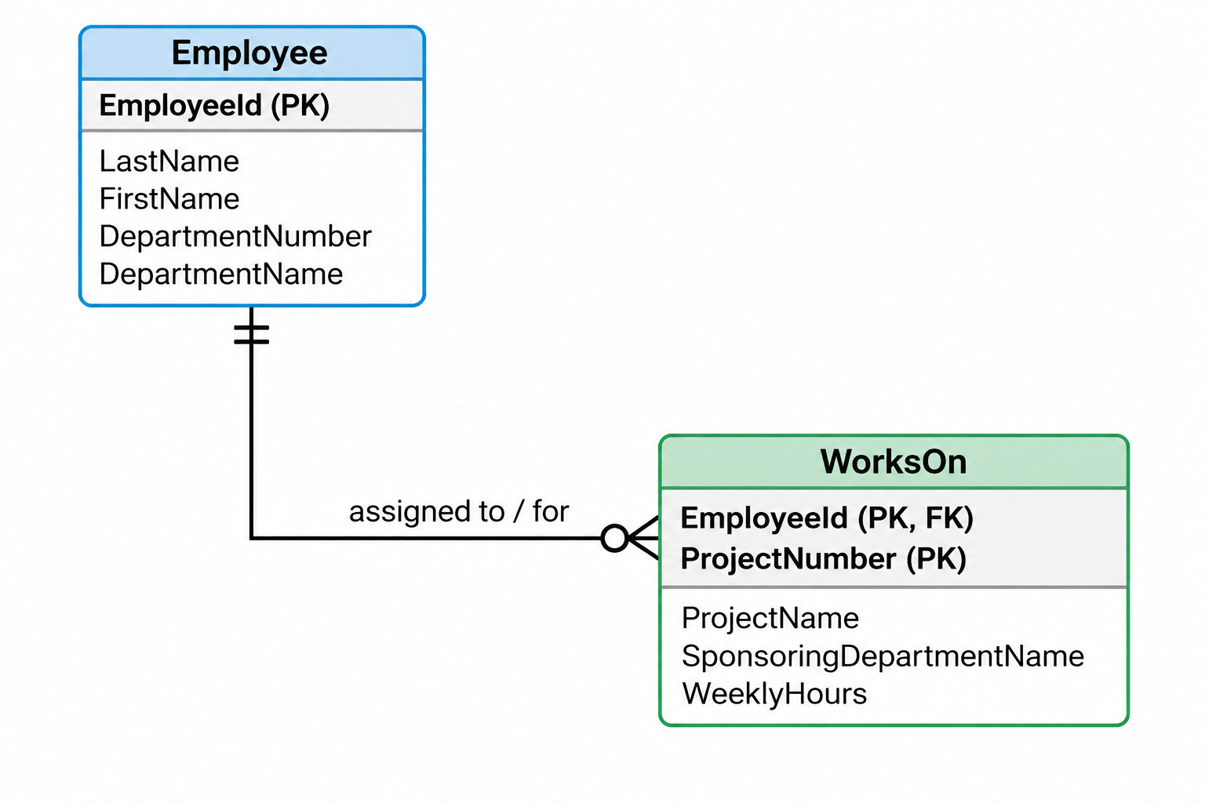
Step 2 — 1NF Result
Employee Table:
Employee(Employee ID, LastName, FirstName, Department Number, Department Name)
WorksOn Table:
WorksOn(Employee ID (FK), Project Number, Project Name, Sponsoring Department Name, Weekly Hours)
Primary Key for WorksOn: Employee ID + Project Number (Composite Key)
Relationship: Employee (1) → WorksOn (M)
The schema is now in First Normal Form (1NF).

Slide 20
Step 3 — Apply 2NF Rules
2NF has one rule:
All non-key attributes in a table must fully depend on the entire primary key of the table.
Key Point:
A violation to 2NF can ONLY occur in a table with a composite primary key.
If a table has a single-attribute primary key, it is automatically in 2NF.
Our tables→
Table | Primary Key | Can 2NF Be Violated?
Employee | Employee ID (single) | No — automatically in 2NF
WorksOn | Employee ID + Project Number (composite) | Yes — must evaluate

Slide 21
Step 3 — Apply 2NF Rules
Question: Is Course Name fully dependent on Student ID?
No — a student can take many courses, so knowing the Student ID doesn't tell you the Course Name.
Question: Is Course Name fully dependent on Course ID?
Yes — if you know the Course ID (BCS245), you know the Course Name (Database Management).
Course Name is partially dependent on Course ID (part of the PK) → 2NF Violation!
Table | Primary Key | Can 2NF Be Violated?
Employee | Employee ID (single) | No — automatically in 2NF
WorksOn | Employee ID + Project Number (composite) | Yes — must evaluate

Slide 22
Step 3 — 2NF Violations in WorksOn
Evaluate WorksOn for partial dependencies. Example:
Attribute | Fully Dependent on Employee ID? | Fully Dependent on Project Number? | Fully Dependent on Both?
Project Name | No | Yes | —
Sponsoring Department Name | No | Yes | —
Weekly Hours | No | No

Slide 23
Step 3 — 2NF Violations in WorksOn
Violations Found. Weekly Hours is fully dependent on both Employee ID and Project Number — it complies with 2NF.
Attribute | Violation | Depends On
Project Name | Partial Dependency | Project Number
Sponsoring Department Name | Partial Dependency | Project Number

Slide 24
EXPLORING: Step 3 — Fixing 2NF Violations
If a partial dependency exists:
Remove the partially dependent attribute(s) from the original table
Place in a new table
Duplicate the primary key attribute(s) they are dependent on and place in the new table
The duplicated attribute(s) become foreign keys in the original table
Designate the cardinality of the relationship
Designate a primary key for the new table
Our fixes→
Attribute | New Table | New PK
Project Name | Project | Project Number
Sponsoring Department Name | Project | Project Number
Note: WorksOn is now an associative entity — the M:N relationship between Employee and Project is fully implemented as two 1:M relationships.

Slide 25
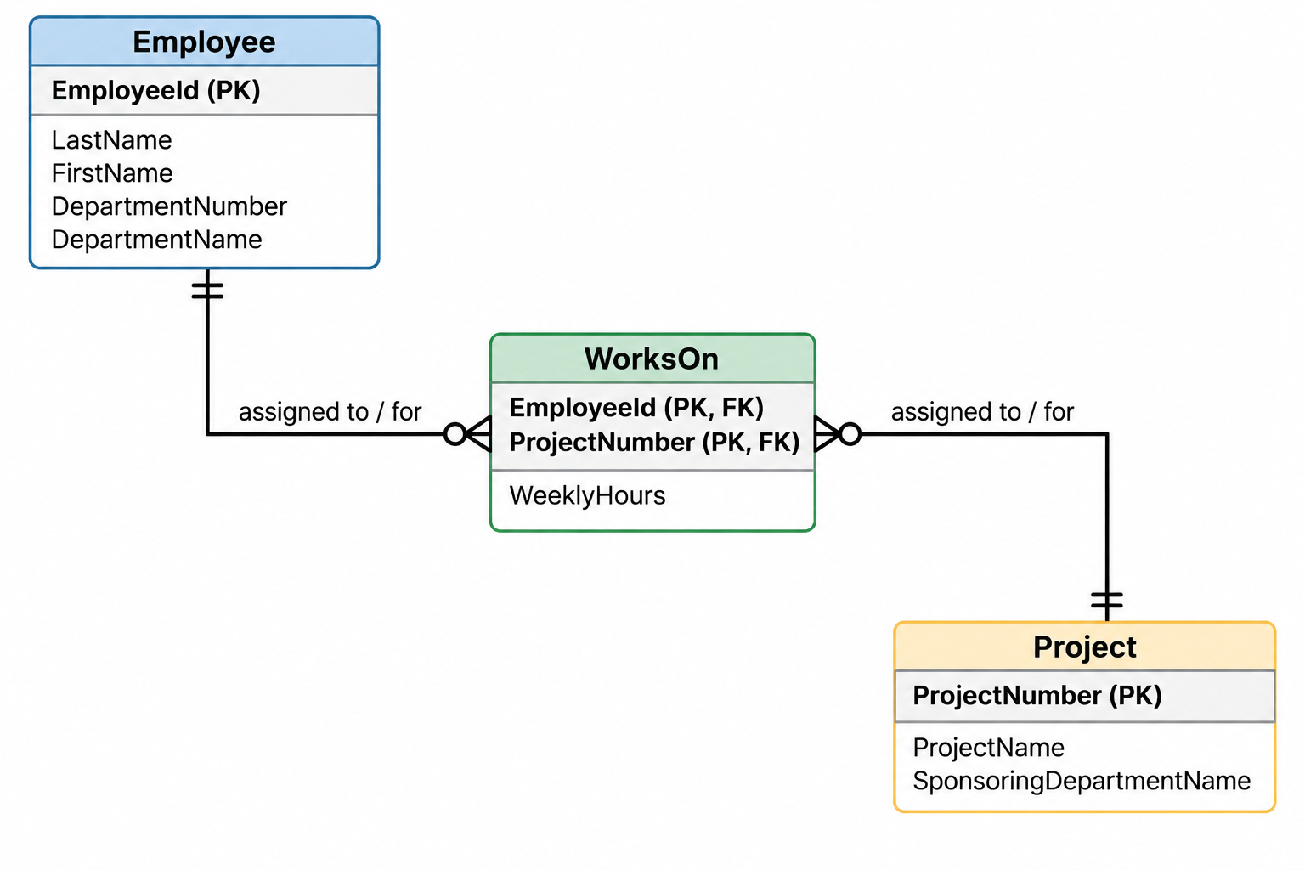
EXPLORING: 2NF ERD
Relationships:
Employee (1) → WorksOn (M)
Project (1) → WorksOn (M)
The schema is now in Second Normal Form (2NF).

Slide 26
Step 4 — Apply 3NF Rule
Table | Non-Key Attributes | Can 3NF Be Violated?
Employee | LastName, FirstName, Department Number, Department Name | Yes — Department Name depends on Department Number
WorksOn | Weekly Hours | No — only one non-key attribute
Project | Project Name, Sponsoring Department Name | No — no dependency between them
3NF has one rule:
A non-key attribute cannot be fully dependent on another non-key attribute.
Key Point:
A table must have two or more non-key attributes for a violation to 3NF to occur.
A non-key attribute that is fully dependent on another non-key attribute is called a TRANSITIVE DEPENDENCY.
Our tables→

Slide 27
Step 4 — 3NF Violation in Employee
Non-Key Attribute | Depends On | Is This a Violation?
LastName | Employee ID | No (depends on PK)
FirstName | Employee ID | No (depends on PK)
Department Number | Employee ID | No (depends on PK)
Department Name | Department Number | Yes — transitive dependency!
Evaluate Employee for transitive dependencies
Why is this a violation?
Department Name is fully dependent on Department Number, which is a non-key attribute.
If you know the Department Number, you know the Department Name — without needing to know the Employee ID.

Slide 28
Step 4 — Fixing 3NF Violations
If a transitive dependency exists:
Remove the transitively dependent attribute(s) and place in a new table
Duplicate the non-key attribute they were dependent on and place in the new table
The duplicated attribute becomes a foreign key in the original table
Designate the cardinality of the relationship
Designate a primary key for the new table
Our fix→
Attribute | New Table | New PK
Department Name | Department | Department Number

Slide 29
Step 4 — 3NF Result
Employee Table:
Employee(Employee ID, LastName, FirstName, Department Number (FK))
Department Table:
Department(Department Number, Department Name)
WorksOn Table:
WorksOn(Employee ID (FK), Project Number (FK), Weekly Hours)
Project Table:
Project(Project Number, Project Name, Sponsoring Department Name)

Slide 30
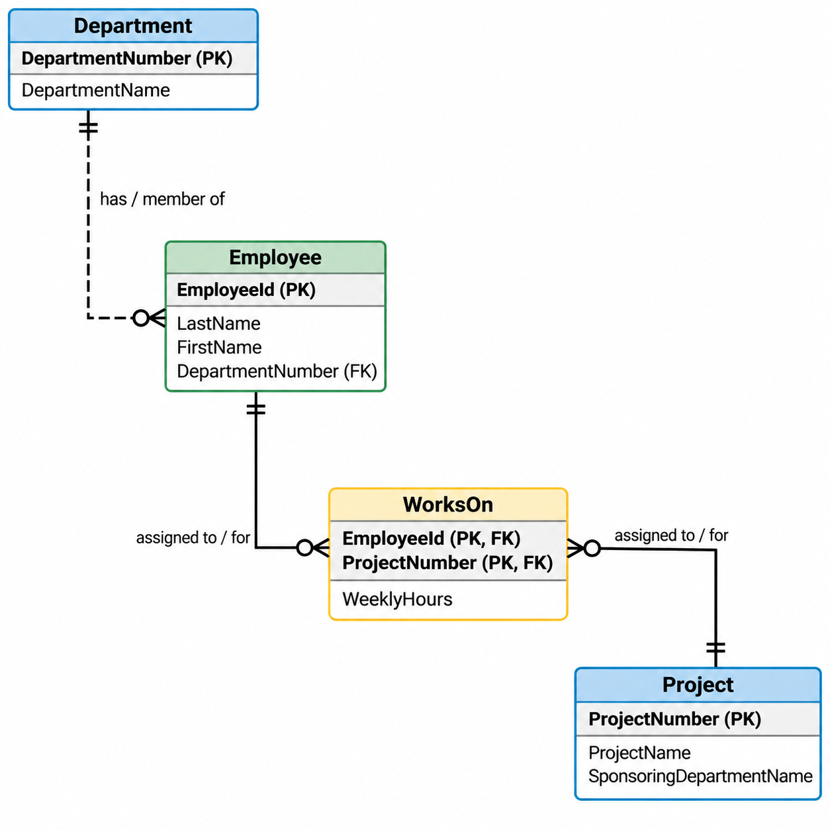
EXPLORING: 3NF ERD (Final Design)
Relationships:
Department (1) → Employee (M)
Employee (1) → WorksOn (M)
Project (1) → WorksOn (M)
The schema is now in Third Normal Form (3NF).

Slide 31
Summary of Normal Forms
Normal Form | Rule | Violation | Fix
1NF | Atomic attributes, no repeating groups | Repeating group | Move to new table, copy PK as FK
2NF | All non-key attributes fully depend on entire PK | Partial dependency | Move to new table, copy PK part as FK
3NF | No non-key attribute depends on another non-key attribute | Transitive dependency | Move to new table, copy non-key attribute as PK/FK

Slide 32
Guided Walkthrough — Movie/Actor
Scenario:
A video rental store tracks movies and actors.
Unnormalized Data:
Movie ID | Movie Title | Actor ID | Actor Name | Role
M001 | Inception | A001 | Leonardo DiCaprio | Cobb
M001 | Inception | A002 | Joseph Gordon-Levitt | Arthur
M002 | The Matrix | A003 | Keanu Reeves | Neo
M002 | The Matrix | A004 | Laurence Fishburne | Morpheus
M003 | Inception | A001 | Leonardo DiCaprio | Cobb

Slide 33
Guided Walkthrough — Movie/Actor
Task: Normalize this data to 3NF.
Step 1: Initial Table
text
Movie(Movie ID, Movie Title, (Actor ID, Actor Name, Role))

Slide 34
Movie/Actor — 1NF
Violations:
Repeating group: (Actor ID, Actor Name, Role)
Fix:
Movie Table:
Movie(Movie ID, Movie Title)
Cast Table:
Cast(Movie ID (FK), Actor ID, Actor Name, Role)
Primary Key for Cast:
Movie ID alone? No — a movie has many actors.
Actor ID alone? No — an actor can be in many movies.
Movie ID + Actor ID? Yes — unique combination.
Cast PK: Movie ID + Actor ID (Composite Key)

Slide 35
Movie/Actor — 2NF
Evaluate Cast for partial dependencies:
Attribute | Fully Dependent on Movie ID? | Fully Dependent on Actor ID? | Fully Dependent on Both?
Actor Name | No | Yes | —
Role | No | No | Yes
Violation Found:
Attribute | Violation | Depends On
Actor Name | Partial Dependency | Actor ID
Fix:
Actor Table: Actor(Actor ID, Actor Name)
Cast Table: Cast(Movie ID (FK), Actor ID (FK), Role)

Slide 36
Movie/Actor — 3NF
Evaluate remaining tables for transitive dependencies:
No transitive dependencies exist.
Final 3NF Design
Table | Non-Key Attributes | Violation?
Movie | Movie Title | No
Actor | Actor Name | No
Cast | Role | No — only one non-key attribute
Movie | Actor | Cast
Movie ID (PK) | Actor ID (PK) | Movie ID (FK) (PK)
Movie Title | Actor Name | Actor ID (FK) (PK)
 |  | Role
Violation Found:

Slide 37
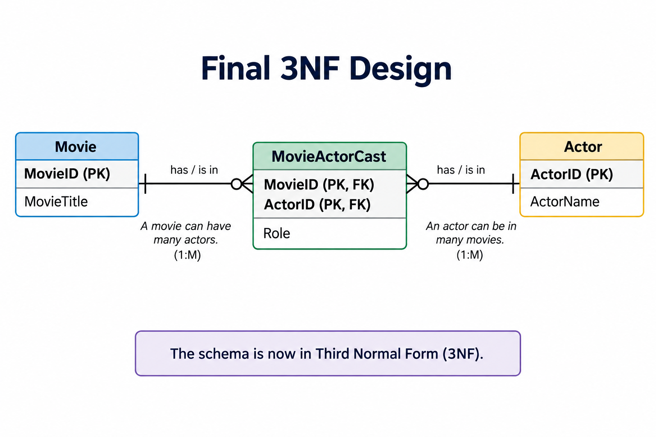
Movie/Actor — 3NF

